Slide 1
Topic :Ratios
Term 4
Year 7 – Ratio & Rates
EQ: What are ratios and how do we use them?

Slide 2
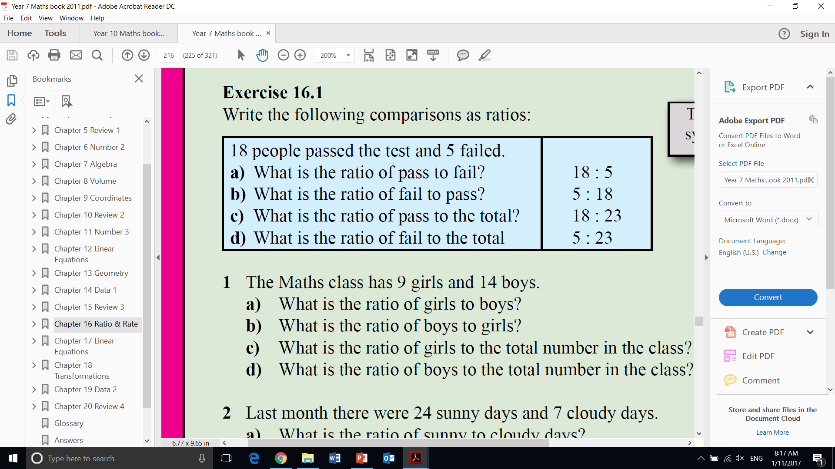
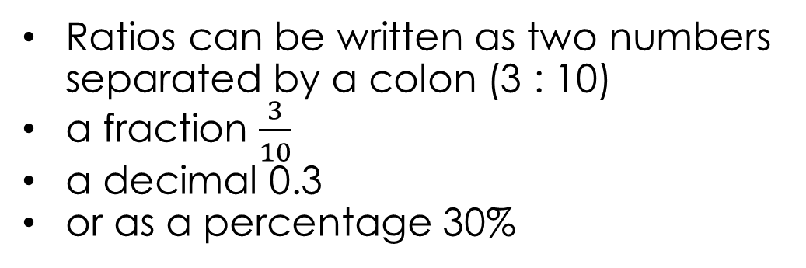
Topic : Ratios
What are ratios and how do we use them?
Ratio
A ratio is a comparison of two quantities of the same type in the same units
How can ratios be represented?
Ratios can be written as two numbers separated by a colon (3 : 10)
a fraction $\frac{3}{10}$
a decimal 0.3
or as a percentage 30%

Slide 3
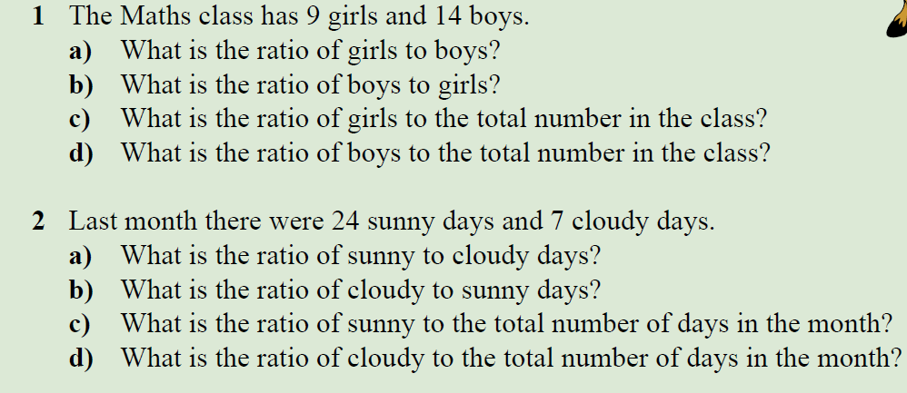
Practice

Slide 4
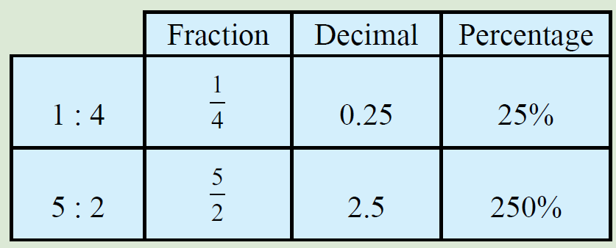
Topic : Ratios
What are ratios and how do we use them?
Converting between fraction decimal and percentage
Fraction → decimal
divide numerator by denominator
decimal → percentage
multiply by 100 and add the percentage symbol %

Slide 5
Practice – add to your table on the left hand side
1: 2
And
2 : 5
Complete pg 216 Dwyer 7

Slide 6
Write your summary
Sentence frame
A ratio is ______________
We can use ratios to _______
To convert ratios to fractions we_________

Slide 7
Topic: Simplifying ratios
EQ: How do we simplify ratios?

Slide 8
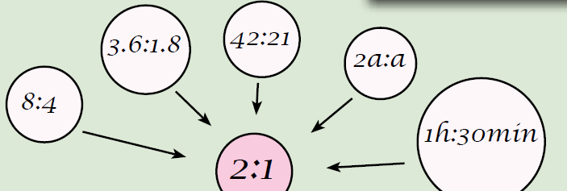
Topic : Ratios
How do we simplify ratios?
When ratios are large or awkward we can simplify them
Simplifying ratios
Find a number that both ratio parts can be divided by.
Both can be divided by 3!
15 : 9
15 ÷ 3 = 5 and 9 ÷ 3 = 3
Simplified ratio is 5 : 3

Slide 9
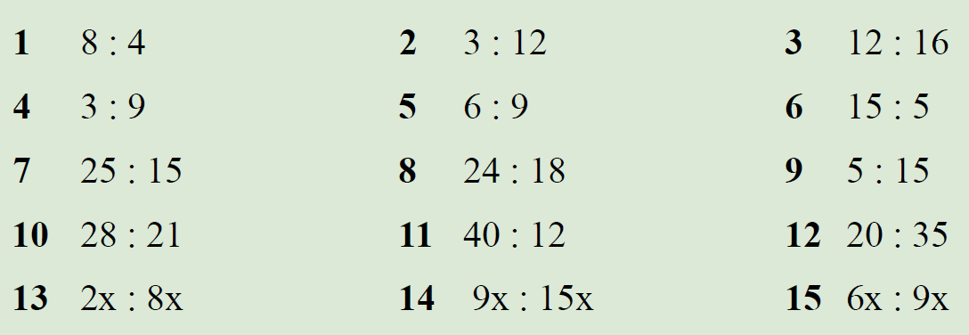
Practice – simplifying ratios (pick 5 to do on LHS)

Slide 10
Miniature Earth - https://vimeo.com/18782842
When do we use ratios??
Before we watch the video you need to fill out the estimation section of your worksheet
As a class we will watch the quick video – Miniature Earth to find the actual ratios
Then you can complete the rest of the questions
Conclusion – discussion questions as a class

Slide 11
Discussion as a class
How many people in this village had a computer or went to university? Do you think it is important for people to have access to these resources?
Give some reasons why Australia’s capacity to sustain a large population is limited.
Given the ratios that you learnt about today, do you think that there is an imbalance of resources? Explain your answer.
What other subjects dis this activity tie into?

Slide 12
Summary.
To simplify ratios we_________

